Slide 1

DriverPass System Analysis
[Malcolm McDonough]
Notes:
[No speaker notes required for this slide.]

Slide 2

System Requirements
Non Functional:
Updates should be made promptly, especially in response to employee changes or the addition of new drivers.
The system should be web-based for easy accessibility.
Functional
Users should be able to track their online test progress.
After login, users should be able to view their profile information.
Notes:
[In your speaker notes, include an explanation of the different requirements you determined for DriverPass’s system. What are the functional requirements you selected to describe? What are the nonfunctional requirements you selected to describe? Be sure to explain how these requirements meet DriverPass’s needs.]

Slide 3
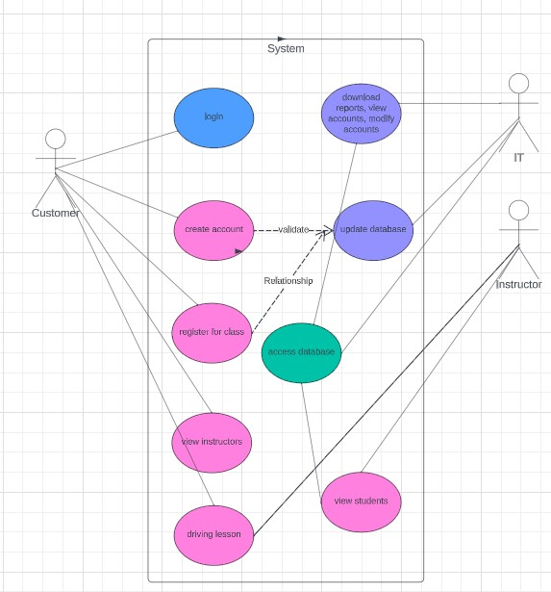
Use Case Diagram
Notes:
Use case diagram where the customer. IT, and instructor can perform actions within the system

Slide 4
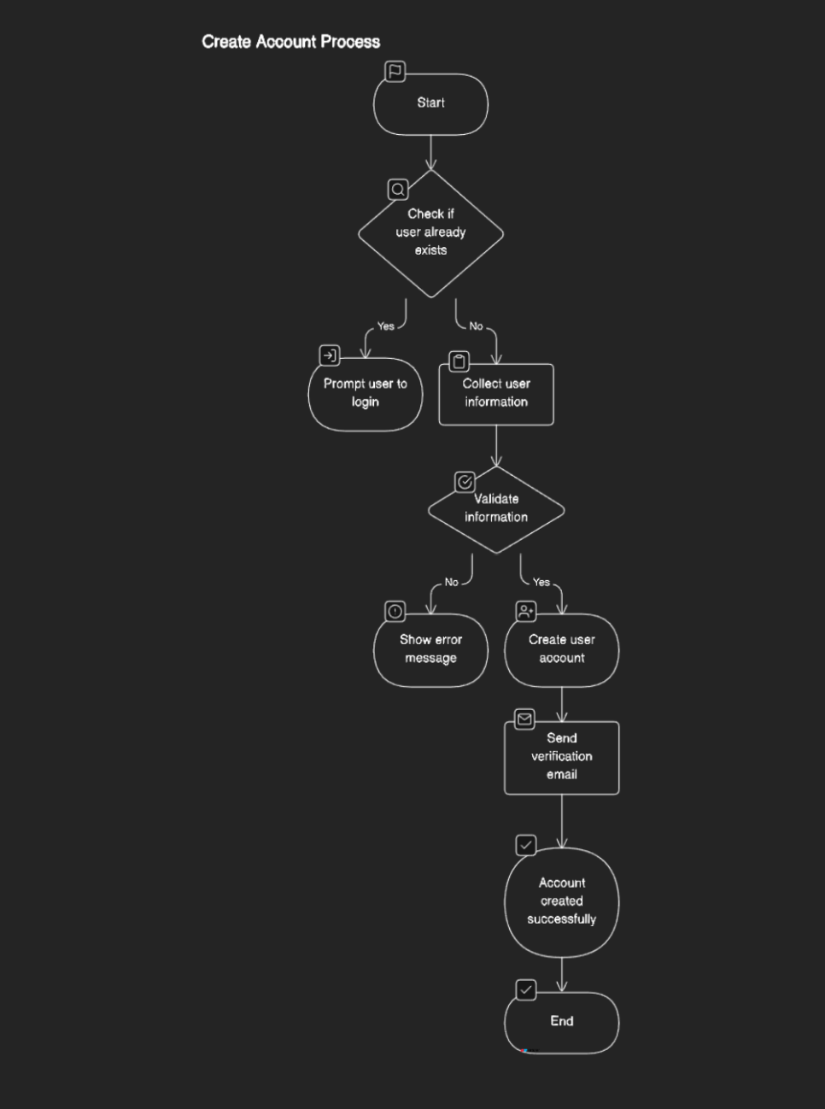
Activity Diagram
Notes:
Activity diagram for creating an account

Slide 5
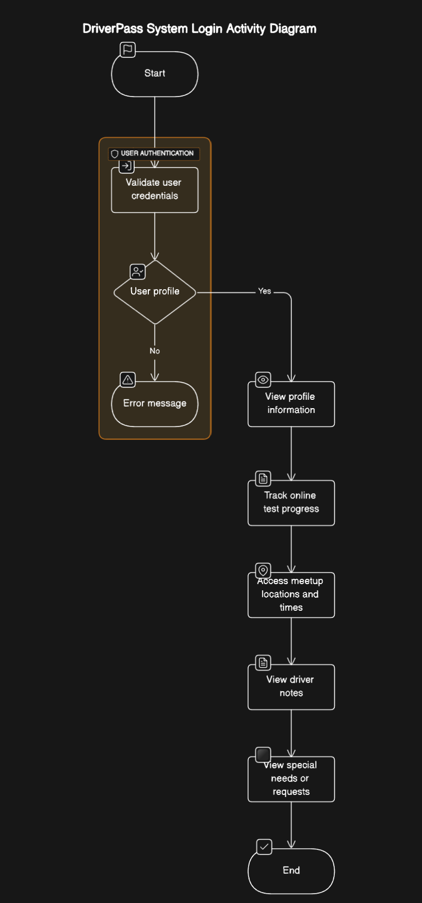
Activity Diagram
Notes:
Activity diagram for logging in, and what the user can view after he logs in

Slide 6
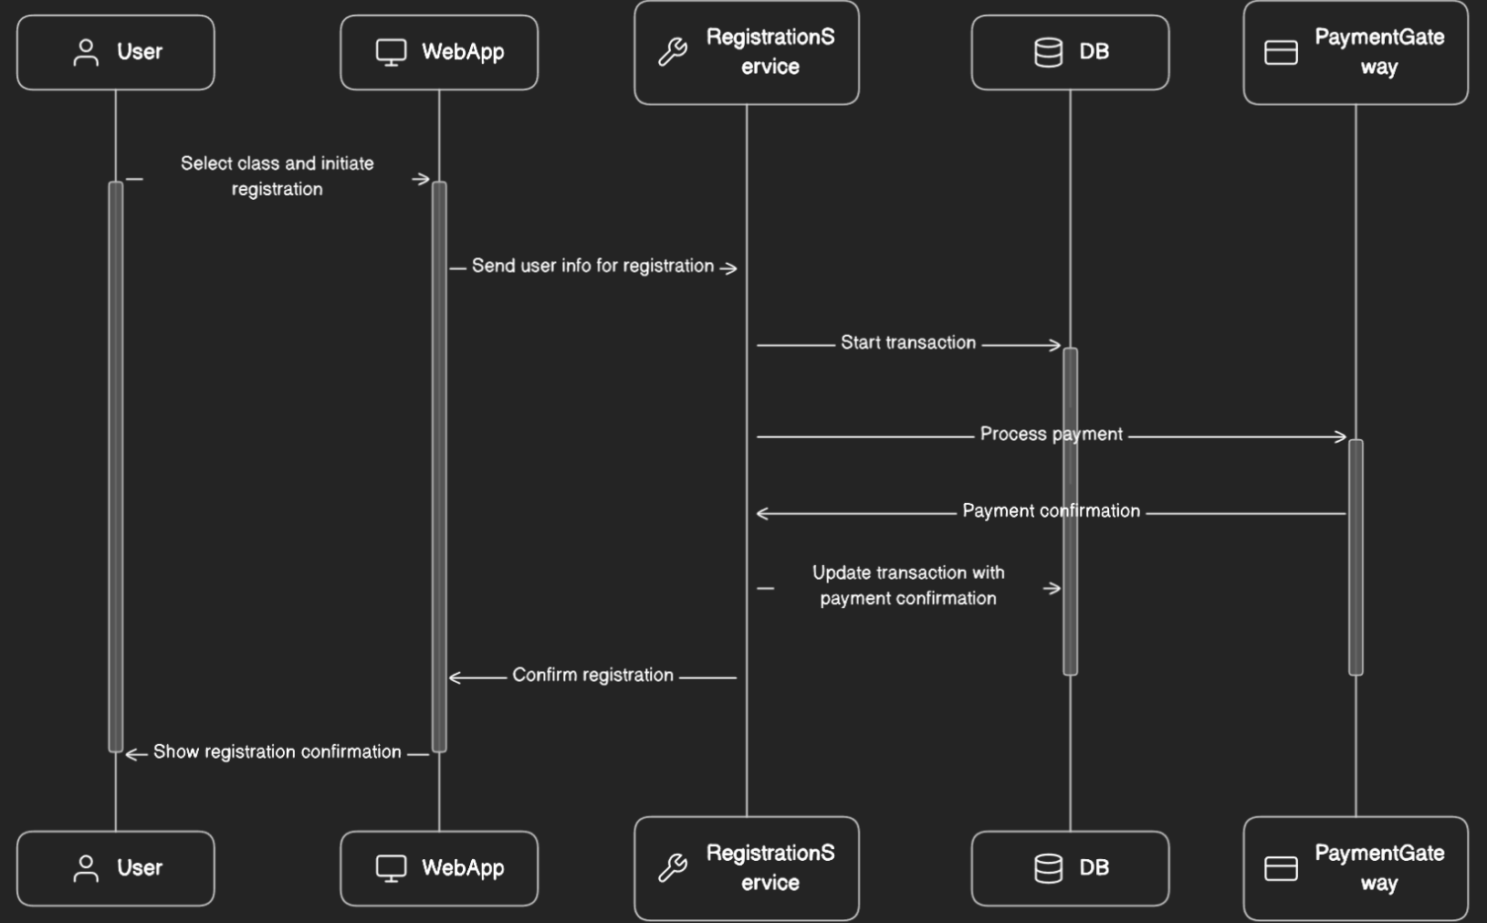
Sequence Diagram
Notes:
Diagrm about the flow to register for the class

Slide 7
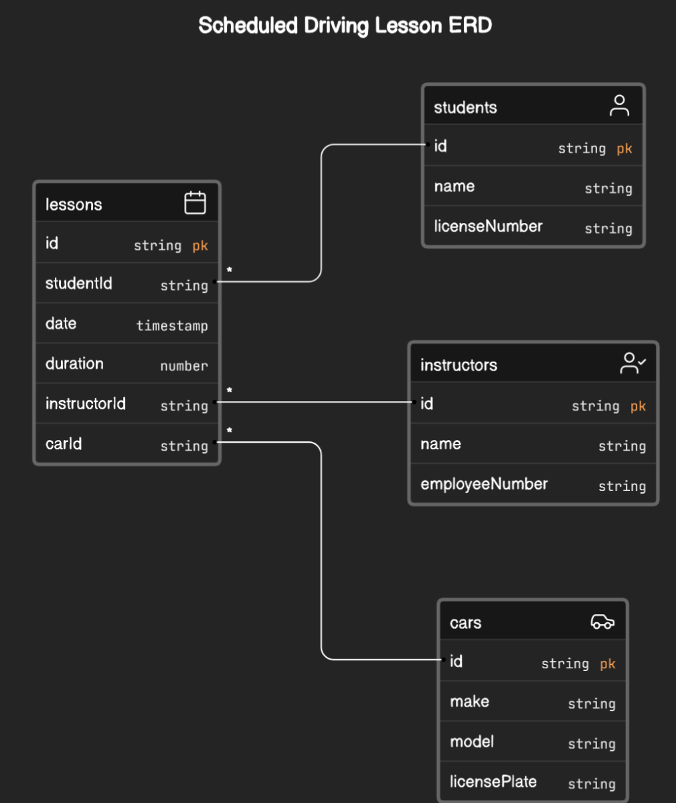
Class Diagram
Notes:
Viewing information about a drivers ed lesson

Slide 8
Security
User authentication should be robust, potentially using 2-factor authentication.
Strong password requirements should be in place.
Account recovery options should be available.
The website should use HTTPS for secure data exchange.
The system should have a user-friendly dashboard for customers to access their training materials and schedule lessons.
It should offer payment processing for different training packages, allowing users to make online payments.
Integration with GPS or mapping services might be necessary to facilitate pickup and drop-off location management.
A notification system should alert users about upcoming lessons and changes to their schedules.
Web app should implement industry compliant standards
Notes:
You should try to build security into the system not bolt it on after

Slide 9
System Limitations
The system is limited to browser access and does not include a mobile app due to resource constraints.
System may be limited by database size or instructor load
Notes:
[What are the limitations of your design? In your explanation, keep your audience in mind by avoiding the use of technical terms.]

